Slide 2
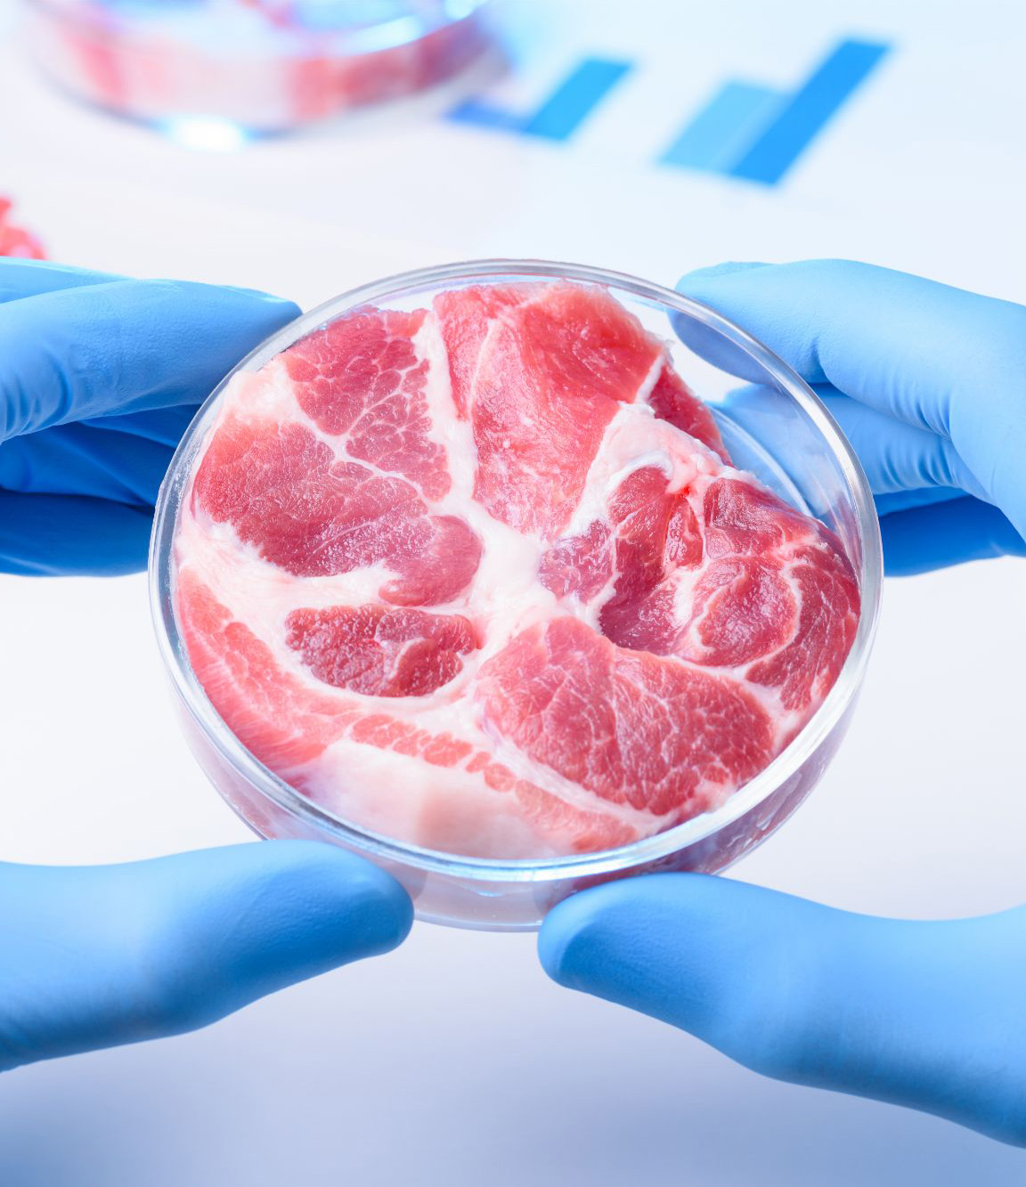
ALL ABOUT CULTURED MEAT
Cultured meat, also known as lab-grown or cell-based meat, is real meat made by growing animal cells in a controlled environment without needing to raise or slaughter animals. An idea that has been around for a long time, Winston Churchill predicted back in 1931 that one day we’d grow just the parts of meat we want without raising whole animals.
Fast forward to 2013, and the first lab-grown burger was introduced by Dr. Mark Post in the Netherlands. It cost over $300,000 to produce, but it showed the world that meat could be made without animals. Since then, the field has grown rapidly. In 2020, Singapore became the first country to approve cultured meat for sale, and the U.S. followed in 2023 with approvals for cultivated chicken from companies like UPSIDE Foods and GOOD Meat.
The process of making cultured meat starts with a small sample of animal cells, usually from muscle or fat. These cells are placed in a bioreactor, a vessel that provides warmth and nutrients so the cells can grow and multiply. The nutrient mix mimics what the animal’s body would naturally provide. Once enough cells have grown, they’re shaped into textures that resemble real meat using edible scaffolds or 3D printing techniques. After a few weeks, the meat is harvested, cooked, and ready to eat. It’s real meat, just made in a different way.
Cultured meat could greatly reduce the environmental impact of food by using less land and water, cutting emissions, and avoiding animal slaughter. It’s antibiotic-free and may be made healthier, but challenges like high costs, scaling production, and consumer hesitation remain. Still, with growing support, it may soon become a sustainable, humane way to enjoy meat.
ACF IOTM
MAY 2025
CULTURED MEAT

Slide 3
HEALTHY INGREDIENT CONTRIBUTION
The innovative protein source of cultured meat offers a range of health-related benefits while maintaining the taste, texture, and nutrient profile of conventional meat and offering potential health advantages such as improved fat composition, enhanced food safety, and the ability to be tailored to meet the needs of health-conscious consumers.
Key Nutritional Contributions (Example: 100g Serving of Cultured Beef Burger Patty)
Calories: ≈170 kcal (8.5% DV)
Total Fat: ≈9-11 g (14-17% DV)
Saturated Fat: ≈3.5 g (18% DV)
Cholesterol: ≈45 mg (15% DV)
Protein: ≈19-22 g (38-44% DV)
Protein builds and repairs muscles, skin, hair, and internal organs.
Iron: ≈2.7 mg (15% DV)
Iron is crucial for making hemoglobin, the protein in red blood cells that carries oxygen throughout the body.
Zinc: ≈5.1 mg (46% DV)
Zinc supports immune function, wound healing, DNA synthesis, and helps with taste and smell.
Vitamin B12: ≈2.4 µg (100% DV)
B12 is essential for making red blood cells, supporting nerve function, and synthesizing DNA.
Other Health Benefits & Advantages
Lean Protein Source: Cultured meat typically provides high-quality, complete protein with all nine essential amino acids, supporting muscle maintenance and growth.
Controlled Fat Profile: Manufacturers can modify the fat composition to include healthier fats (e.g., omega-3 fatty acids), potentially reducing the intake of harmful saturated fats.
No Antibiotics or Hormones: Unlike conventional meat, cultured meat is produced without antibiotics or growth hormones, reducing exposure to harmful residues and resistance risks.
Reduced Pathogen Risk: The sterile, controlled production environment greatly reduces the risk of contamination by pathogens like E. coli, Salmonella, or Listeria.
Nutritional Information/Values from USDA FoodData Central
ACF IOTM
MAY 2025
CULTURED MEAT

Slide 4
TYPES AND VARIETIES
As the technology of cultured meat matures, a growing variety of meat types and formats are becoming available, catering to both traditional preferences and culinary innovation.
Cultured Beef
One of the first and most researched types of cultured meat.
Made from muscle stem cells taken from cows.
Cultured Chicken
Produced from avian muscle cells, often using bioreactors for scalable production.
Approved for sale in Singapore and the United States.
Cultured Pork
Derived from pig muscle and fat cells.
It can replicate the flavor and texture of traditional pork.
Cultured Seafood
Includes fish and shellfish varieties produced without overfishing or marine habitat destruction.
Avoids mercury, microplastics, and antibiotic contamination commonly found in wild-caught seafood.
Cultured Lamb & Other Red Meats
Companies are working on lamb, goat, and even game meats like venison.
Opportunity to tailor omega-3 content and lower saturated fats.
Cultured Fat
Grown specifically to replicate the flavor-enhancing properties of animal fat.
Can be combined with plant-based proteins or cultured lean meat to enhance juiciness, mouthfeel, and aroma.
Hybrid Products
Blends cultured meat with plant-based ingredients for a balanced, scalable solution.
Improved texture, reduced cost, and added fiber or functional ingredients.
Emerging Possibilities:
Cultured Milk & Dairy
Cultured Foie Gras
Cultured Exotic Meats
Cell-Based Collagen
Cell-Based Gelatin
ACF IOTM
MAY 2025
CULTURED MEAT

Slide 5
SELECTING AND STORING
As cultured meat becomes more available on the market, understanding how to select and store it properly is key to maintaining quality, safety, and flavor. While similar to conventional meat in many ways, cultured meat has a few unique considerations due to its controlled production and composition.
Selecting Cultured Meat:
Packaging & Labeling
Look for trusted certifications or regulatory approvals such as USDA, FDA, or equivalent international food safety authorities.
Packaging often notes whether the product is 100% cultured or a hybrid combined with plant-based ingredients.
Check for claims like no antibiotics or hormones, grown in a sterile environment and custom fat composition” or “omega-3 enriched”
Appearance
Fresh cultured meat should have a clean color: pink to red for red meats, pale for poultry, translucent or pinkish for seafood.
Products designed for raw consumption such as sashimi-style cultured tuna should appear firm and glossy.
Format
Select your cultured meat format based on how you plan to cook it.
Ground formats are ideal for burgers and meatballs.
Structured cuts or filets are best for grilling and roasting.
Storing Cultured Meat:
Refrigeration
Uncooked cultured meat should be kept at ≤ 40°F (4°C) and consumed within 2–3 days of opening, unless otherwise indicated.
Vacuum-sealed or modified atmosphere packages may last longer. Follow the manufacturer’s “use by” or “best before” date.
Freezing
Most cultured meat can be frozen at 0°F (-18°C) for up to 6 months, though texture may be slightly affected depending on fat content and structure.
For best results, wrap in airtight containers or freezer-safe bags to prevent freezer burn.
Thawing
Thaw safely in the refrigerator overnight, not at room temperature.
For quick thawing, place sealed packaging in cold water and cook immediately after.
Cooked Storage
Store cooked cultured meat in the refrigerator for up to 4 days or freeze for longer storage.
Reheat to 165°F (74°C) to ensure food safety and best texture.
ACF IOTM
MAY 2025
CULTURED MEAT

Slide 6
CULINARY USES
Cultured meat is revolutionizing the culinary landscape by offering chefs, home cooks, and food innovators a sustainable and customizable alternative to conventional meat. Thanks to its clean production process and precise control over fat and muscle composition, cultured meat lends itself to a wide range of creative applications across global cuisines.
Grilling & Searing Applications
Ideal for burgers, steaks, & kebabs
Even fat distribution = perfect caramelization
Juicy interior & flavorful throughout
Slow Cooking & Braising Applications
Great for stews, ragu, and pulled meats
Tender results with consistent texture
No tough sinew or gristle
Ground & Minced Applications
Perfect for meatballs, tacos, dumplings & sausages
Clean flavor adapts well to global spice blends
Reliable, uniform cook quality
Marinated & Cured Meat Applications
Prime for quick-marinated skewers & fajitas
Cell-based charcuterie being researched
Sous-vide for ultra-precise internal texture & moisture
Fast Casual Applications
Performs well in sliders, nuggets, & burritos
Scalable for foodservice and meal kits
Maintains taste and texture in reheating
Lightly Cooked & Raw Applications
Potential for tartare, carpaccio, pho, & hot pot
Sterile production supports food safety
Optimal tenderness & flavor
Seafood Applications
Options like shrimp, tuna, and salmon are emerging
Great for sushi, ceviche, & seafood pasta dishes
Traceable and ocean-friendly
Pizza & Flatbread Applications
Cultured sausage crumbles & pepperoni-style meats
Lower grease runoff & better control of browning
Works well on naan pizzas, focaccia, & tortillas
Plant-Based Blend Applications
Hybrid meat-veggie burgers or meatballs
50/50 blends with mushrooms, lentils, or grains
Ideal for flexitarians seeking lower meat intake
Institutional & Customized Meal Applications
Elder care & hospital meals with custom textures or nutrition
School lunches with tailored nutrition & low contamination risk
Military, space, or remote location rations with long shelf-life
ACF IOTM
MAY 2025
CULTURED MEAT

Slide 7
INTERESTING FACTS
The concept of cultured meat dates back to the 1990s, when NASA explored growing meat in space by cultivating animal cells in vitro.
Today, cultured meat is being considered as a protein source for space missions and future Mars colonies.
Cultured meat production could use up to 95% less land and 78–96% less water than traditional livestock farming, making it an environmental game-changer.
Livestock farming accounts for nearly 15% of global greenhouse gas emissions so cultured meat could potentially reduce emissions by up to 90% depending on the production method.
Early versions of cultured meats were mostly ground, but now companies are creating structured steaks, filets, and even marbled meats.
With cultured meat, you can skip the bones and hooves and grow only the parts people love most such as the tenderloin.
Since it can be grown without pathogens like Salmonella or E. coli, chefs and manufacturers may explore raw or rare preparations that are traditionally riskier with conventional meat.
Scientists have already used resurrected mammoth DNA (mixed with elephant muscle cells) to grow a woolly mammoth meatball.
In the future, children might grow up thinking it’s totally normal to have tech-grown burgers—and may never associate meat with animal farming.
ACF IOTM
MAY 2025
CULTURED MEAT

Slide 8
RECIPE
Cultured Beef Smash Burgers with Umami Aioli Yield: 4 Servings
Ingredients:
Umami Aioli:
1/2 Cup Kewpie Mayonnaise
1 Tsp White Miso Paste
2 Tsp Roasted Garlic
1 Tsp Yuzu Juice
1/8 Tsp Soy Sauce
1/8 Tsp MSG
Burgers:
1 Lb Cultured 80/20 Ground Beef
1 Tbsp Cultured Beef Fat
Salt & Ground Black Pepper
4 Brioche Buns, Halved and Toasted
4 Slices Gouda Cheese
Bread-and-Butter Pickles
Butter Lettuce Leaves
Clarified Butter, For Cooking
Directions:
In a small bowl, mix the mayo, miso paste, roasted garlic, yuzu juice, and soy sauce in a small bowl. Blend until smooth and creamy.
Taste, adjust for seasoning, and then chill until ready to use.
In a medium bowl, thoroughly combine the cultured ground beef and fat.
Divide the cultured beef into 4 equal balls but don’t flatten them. Keep them loosely packed for max crust formation.
Heat a cast-iron skillet or flat-top griddle over medium-high heat until nearly smoking. Add a drizzle of clarified butter.
Place 2 meatballs on the hot surface and smash them flat with a spatula until ¼-inch thick. Season generously with salt and pepper.
Let cook without moving for about 2–3 minutes, until the edges are deeply browned and crispy.
Flip once, add cheese, cook another 1–2 minutes and remove from pan. Repeat with remaining patties.
Assemble the burgers by first spreading umami aioli on the bottom bun. Add pickles, a burger patty, and lettuce leaves. Cap with the top bun (add more aioli if desired) and serve warm.
ACF IOTM
MAY 2025
CULTURED MEAT

Slide 9
QUIZ
After you read through this month’s Ingredient of the Month, take this quiz to test your knowledge. In order to earn continuing education hours (CEHs) from the American Culinary Federation (ACF), the test must be completed through the ACF’s Online Learning Center. Seventy-five percent accuracy is required to earn one hour of continuing education credits toward professional certification.
ACF IOTM
MAY 2025
CULTURED MEAT

Slide 10
QUIZ
Question #1
Who predicted in 1931 that we would one day grow only the parts of meat we want?
Albert Einstein
Nikola Tesla
Winston Churchill
Thomas Edison
ACF IOTM
MAY 2025
CULTURED MEAT

Slide 11
QUIZ
Question #2
What is a bioreactor used for in cultured meat production?
Shaping the meat into final forms
Providing warmth and nutrients for cell growth
Preserving the final product for consumption
Cooking the meat to kill bacteria
ACF IOTM
MAY 2025
CULTURED MEAT

Slide 12
QUIZ
Question #3
Cultured meat contains zero fat, making it ideal for every diet.
True
False
ACF IOTM
MAY 2025
CULTURED MEAT

Slide 13
QUIZ
Question #4
Which essential nutrient in cultured meat supports immune function and helps with taste and smell?
Calcium
Iron
Vitamin C
Zinc
ACF IOTM
MAY 2025
CULTURED MEAT

Slide 14
QUIZ
Question #5
What is one benefit of cultured lamb and other red meats being developed?
Customizable omega-3 levels
Ability to eliminate all protein
Increased saturated fat
Cross-breeding flavors
ACF IOTM
MAY 2025
CULTURED MEAT

Slide 15
QUIZ
Question #6
Which claim might you find on a package of cultured meat?
Grass-fed and cage-free
Custom fat composition
Grown with antibiotics
Dry-aged and wood-smoked
ACF IOTM
MAY 2025
CULTURED MEAT

Slide 16
QUIZ
Question #7
What is the recommended refrigerator temperature for storing uncooked cultured meat?
Room temperature
50°F (10°C)
45°F (7°C)
40°F (4°C) or below
ACF IOTM
MAY 2025
CULTURED MEAT

Slide 17
QUIZ
Question #8
The clean production process of cultured meat supports lightly cooked or raw dishes like tartare and carpaccio.
True
False
ACF IOTM
MAY 2025
CULTURED MEAT

Slide 18
QUIZ
Question #9
How much less land could cultured meat use compared to traditional livestock farming?
Up to 95%
Up to 75%
Up to 25%
Up to 5%
ACF IOTM
MAY 2025
CULTURED MEAT

Slide 19
QUIZ
Question #10
Why should the cultured beef burger patties be loosely packed before smashing?
To make them easier to flip
To avoid overcooking
To create a moist center
To maximize crust formation
ACF IOTM
MAY 2025
CULTURED MEAT

Slide 20
JOIN US NEXT MONTH!
Stay tuned for the next ACF Ingredient of the Month! Be sure to visit the Online Learning Center (OLC) to download a copy of each month’s ingredient presentation. Don’t forget to take the official IOTM quiz through the OLC to earn one hour of continuing education credits toward professional certification.
For more information:
www.acfchefs.org
www.acfchefs.org/olc
www.acfchefs.org/iotm
ACF IOTM
MAY 2025
CULTURED MEAT

